Slide 1
TELCO CUSTOMER CHURN
Business Analytics Case Study
Why Are Customers Leaving and How Can We Stop Them?
Vivian Okoaze
Sales & Product Analyst

Slide 2
Business Problem Statement
Key Business Concern
The telecommunications company is experiencing a customer churn rate of 26.54% resulting in revenue loss and increased customer acquisition costs.
Key Questions:
Why are customers leaving the company?
Which factors contribute most to churn?
Which customers are at highest risk right now and need immediate intervention?
What service, contract, and billing characteristics are associated with churn?
Which segments need urgent retention action?
Project Objective
The objective of this analysis is to identify the factors contributing to customer churn and recommend strategies to improve customer retention.

Slide 3
The Customer Churn dataset contains information about customers of a telecommunications company and is designed to help analyze why customers discontinue their services. Each record represents one unique customer and their relationship with the company.
Dataset Overview
Total Records
Features
Churned
Retained
Missing
7,043
21
5,174
11 Rows (Replaced)
1,869
Key Data Categories
Key Performance Indicators (KPIs)
Demographics | Senior Citizen, Partner, Gender, Dependents
Identifier | CustomerID
Services | Internet Service, Online Security, Phone Service, Multiple Lines, Online Backup, Tech Support, Streaming TV, Streaming Movies, Device Protection
Billing Information | Monthly Charges, Total Charges
Account Information | Contract, Payment Method, Tenure, Paperless Billing
Target Variable | Churn (Yes/No)
Total Customers | 7,043
Churned Customers | 1,869
Churn Rate | 26.54%
Active Retained Monthly Charges | 61
Average Churned Tenure | 18 months
Average Monthly Charges | 64.76%
Average Tenure | 32.37

Slide 4
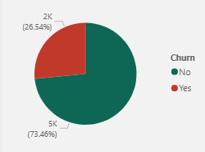
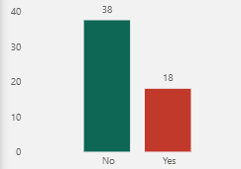
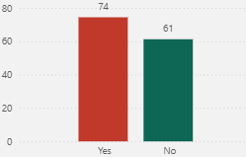
Financial Comparison: Churned vs Retained Customers
Overall Churn Split
Avg Tenure (Months)
Avg Monthly Charges
26.5%
18 months
$74
Overall churn rate
(above 15–20% benchmark)
Shorter stay
(18 vs 38 months)
Higher monthly cost
(Churned vs Retained)

Slide 5
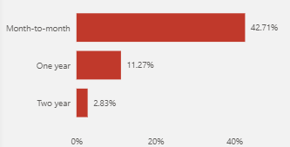
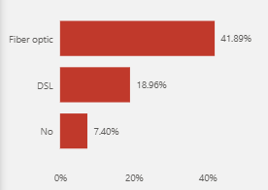
Contract Type & Internet Service
Churn by Contract Type
Churn by Internet Service
Month-on-month 42.71% churn
Fiber optic customers churn at 41.89%

Slide 6
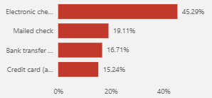
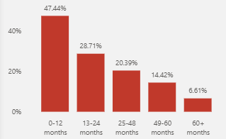
Payment Method & Customer Tenure
Churn by Payment Method
Churn by Tenure Group
Electronic check users churn at 45.29%
New customers (0-12 months) churn at 47.44%

Slide 7
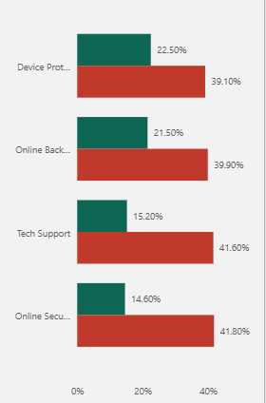
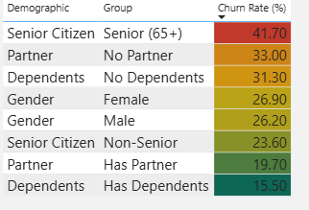
Add-On Services & Demographics
Churn by Add-on Service
Churn by Demographic Factors
Customers without Tech Support or Online Security churned more frequently.
Senior citizens showed a higher churn rate than younger customers.

Slide 8
Recommendations
Contract Upgrade Campaign: Offer month-to-month customers 10–15% discount to switch to annual contracts. Target 6+ month customers first.
Fix the Fiber Experience: Audit fiber quality, introduce a Fiber Guarantee with bill credits, and add proactive retention calls for new fiber users.
New Customer Onboarding: Structured 90-day journey: welcome call (Day 1), check-in (Day 30), cross-sell offer (Day 60), loyalty milestone (Day 90).
Bundle Add-On Services: Include Online Security & Tech Support in base plans. Each add-on reduces churn by 20–27pp retention ROI far exceeds cost.
Auto-Payment Incentive: Offer $5/month bill credit to electronic check users who switch to automatic payment. Saves ~30pp in churn risk.
Senior Citizen Program: Dedicated support line, simplified billing, and a modest 5–8% monthly discount for customers aged 65+.

Slide 9
Conclusion
Customer churn is not random it is predictable, concentrated, and preventable.
The data shows clear, actionable patterns:
month-to-month contracts, fiber optic dissatisfaction, electronic check payment and the critical first-year window together account for most of the churn risk. Customers who stay past year one, adopt add-on services, sign longer contracts, and use automatic payment churn at under 15%.
The company already knows what a loyal customer looks like the goal is to engineer more customers toward that profile from Day 1.

